Slide 1

Computer Programming Internship Project Presentation
7/1/2020
Jakob Wagner

Slide 2


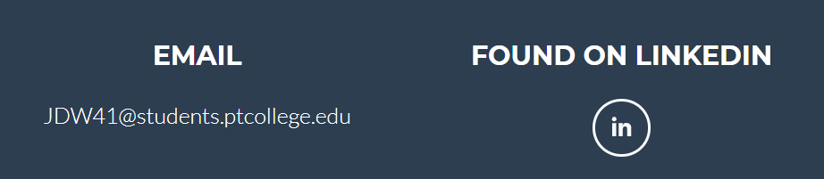
Web Interface - Basics
Navbar scrolls down the page
Three different sections: Portfolio, About, and Contact

Slide 3
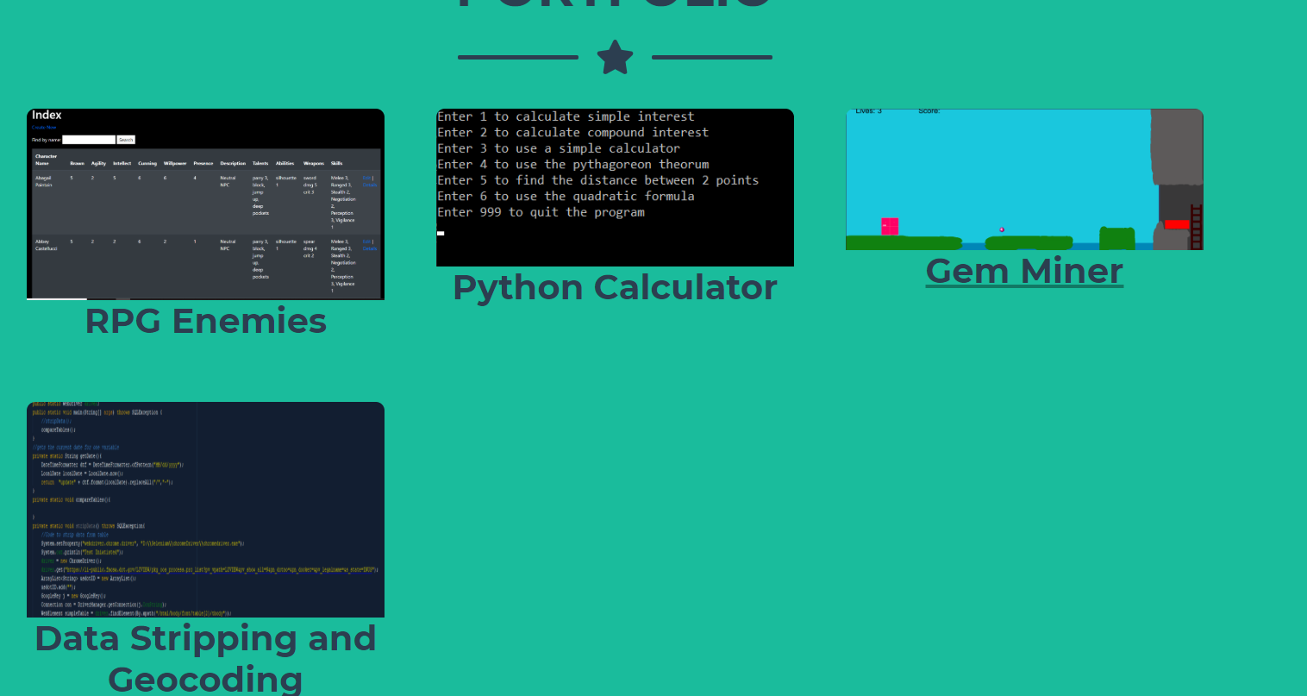
Web Interface - Portfolio
Portfolio section contains cards for different projects
Each card takes you to the individual Page of its project

Slide 4
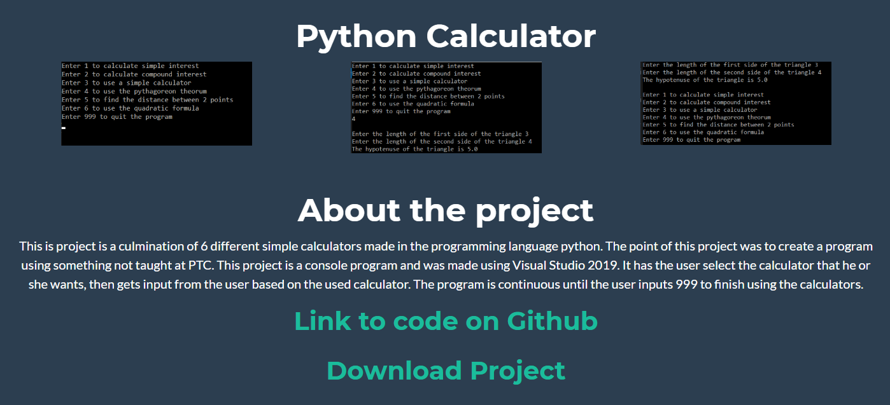
Web Interface - Projects
Project name
Pictures of project
Description of project
Link to Github
Project Download

Slide 5
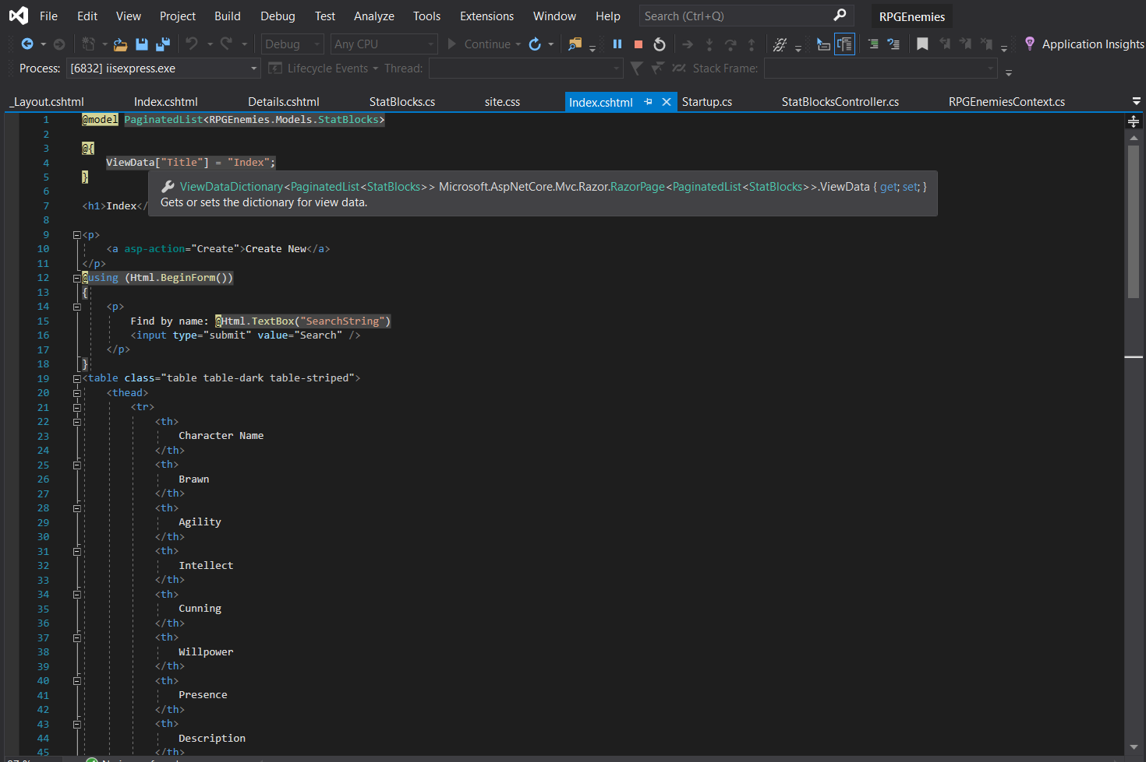
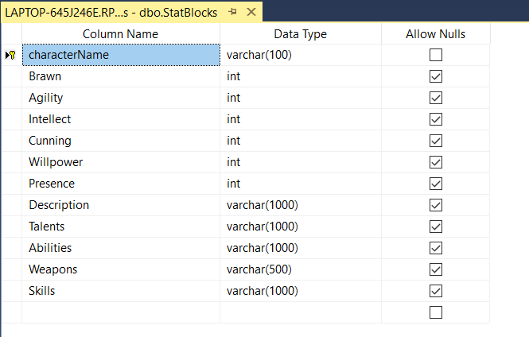
Project 1 - Basics
Project is an MVC Website
Visual Studio 2019
Database is in SQL Server Management Studio

Slide 6
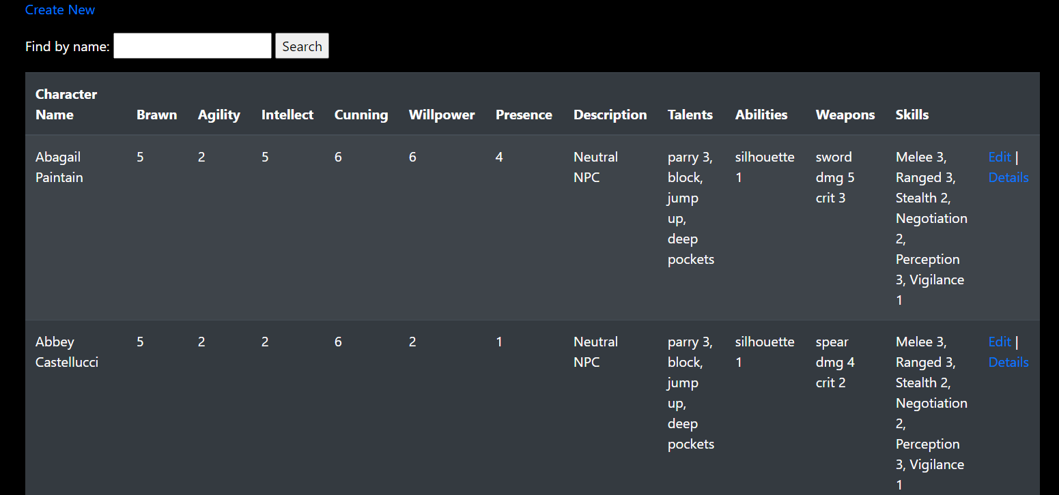
Project 1 - Description
Stat blocks for NPCs
Name
Characteristics
Talents
Abilities
Skills
Weapons

Slide 7
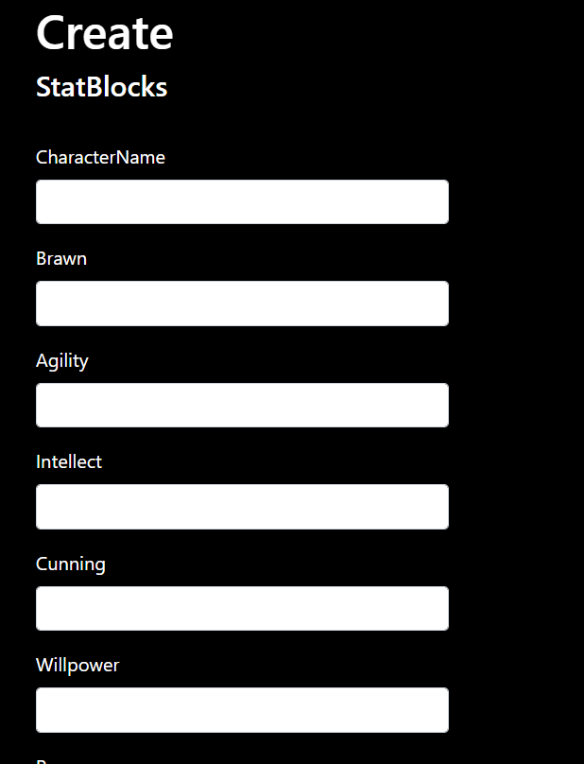
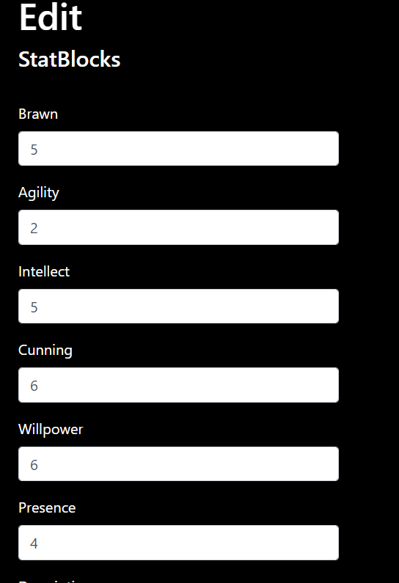
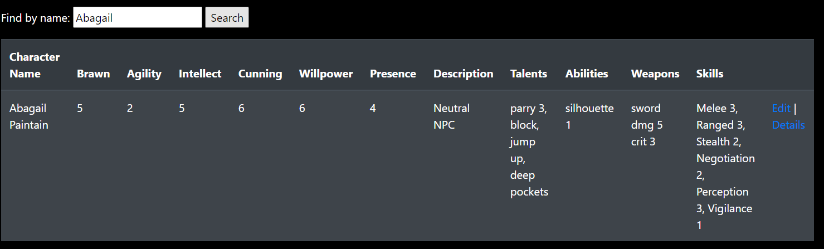
Project 1 - Input
Create new database entries
Edit existing entries
Search entries

Slide 8
Project 1 - Process
Languages
HTML
SQL
Connects to database
Database holds the data
Website filters and processes data

Slide 9
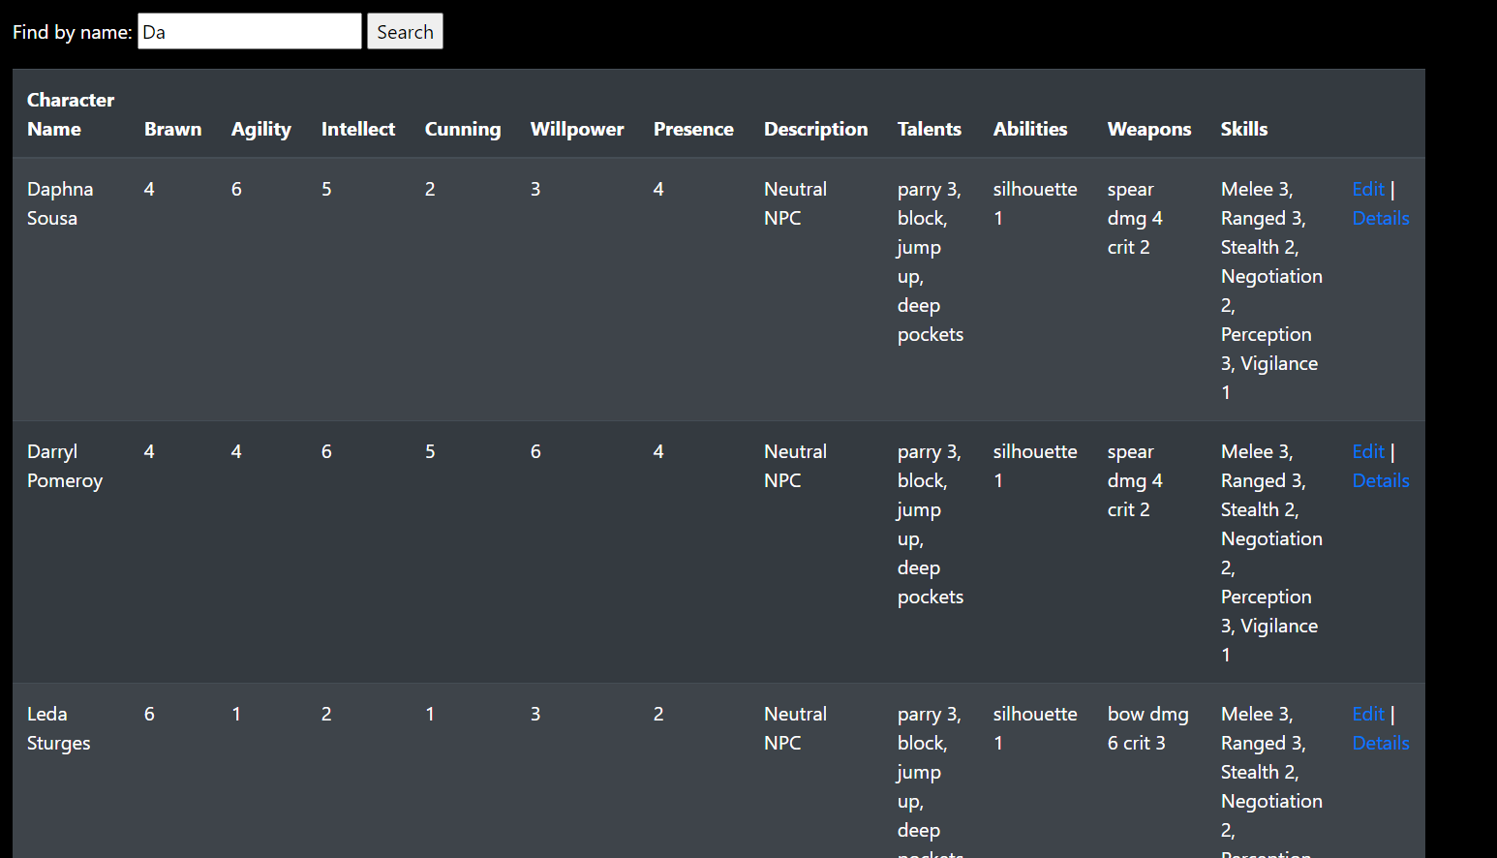
Project 1 – Output
New entries in database
Updated entries in database
Views entries with similar names

Slide 10
Reflection
Website that I will use
Program effective
Design needs improved
Program can be cleaner

Slide 11
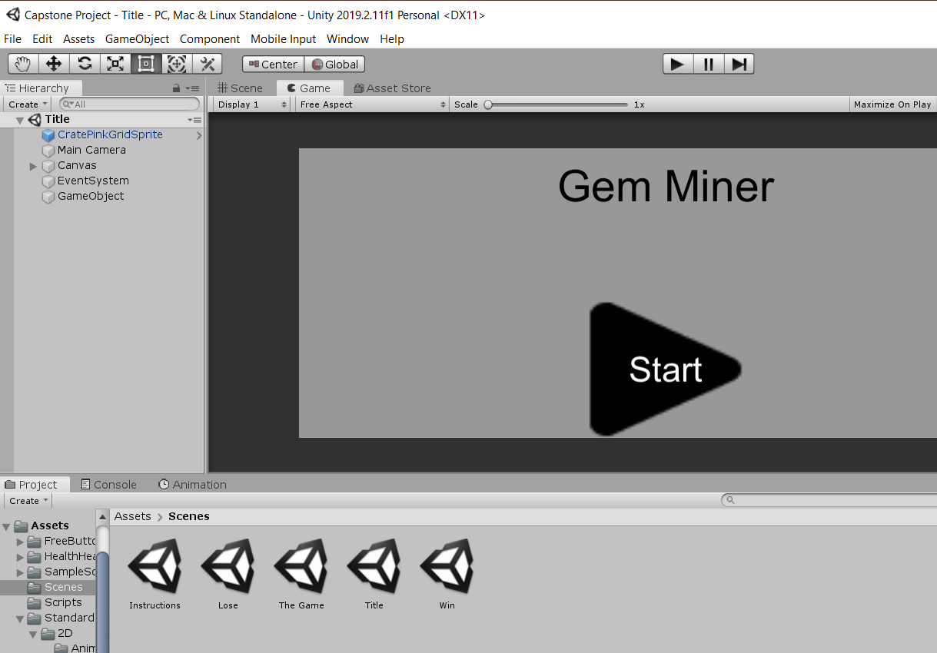
Project 2 - Basics
Project is a 2D Unity game
Created in Unity
Scripts created in Visual Studio 2017
Graphics created using GIMP or free Unity assets

Slide 12
Project 2 - Process
C# was the programming language used
Spikes cause you to restart level with one less live
Falling causes you to restart level with one less live
Ladders moves player to next level & changes the camera
4 Levels

Slide 13
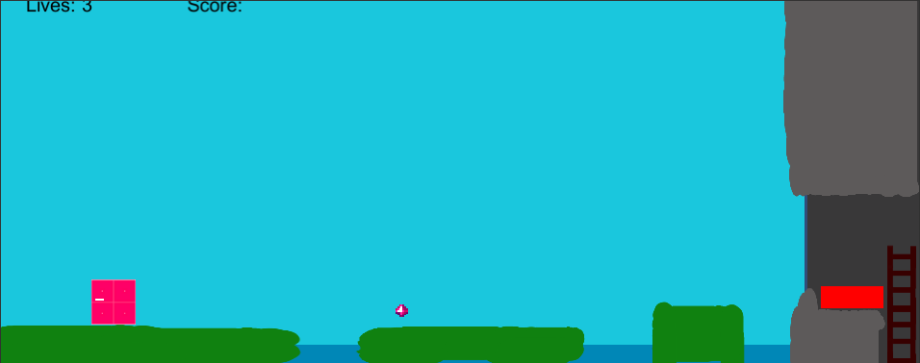
Project 2 - Description
Play as pink square
Platformer game
Collect all the gems to win
Lose all lives or fail to collect gems to lose

Slide 14

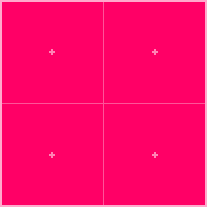
Project 2 - Player
Player moves using arrow keys
Collecting gems increase score
Hitting spikes causes player to lose lives
Falling off stage causes player to lose lives
Reaching the ladder continues to next level

Slide 15
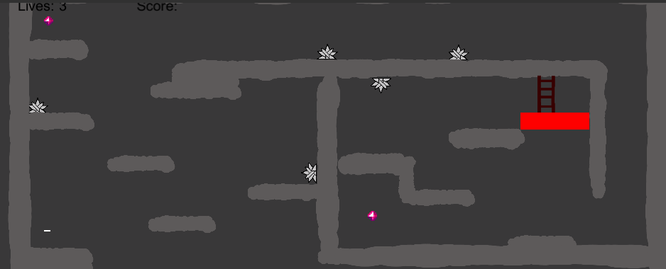
Project 2 - Graphics
Most graphics have been replaced/updated
White rectangles replaced with gray irregular shapes
Gave most levels cave background
All graphics made by me. Exceptions:
Red Rectangles
Player Character
Buttons
Gems
Music

Slide 16
Reflection
Decently fun game
The gameplay mechanics are relatively bug free
I suck at graphic design
Took some trial & error for code
Couldn’t fix some things. Had to be scrapped

Slide 17
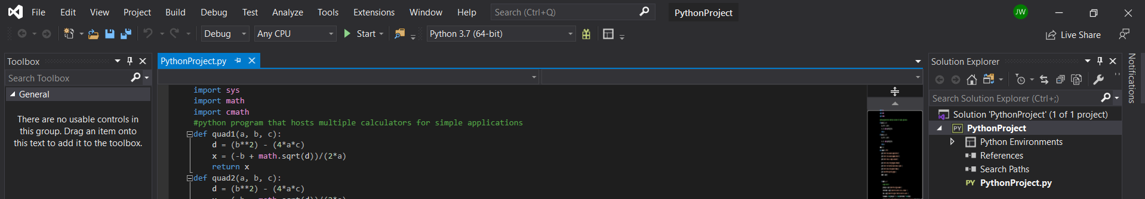
Project 3 - Basics
Project is multiple calculators in one application
Visual Studio 2019
Project was something self-taught

Slide 18

Project 3 - Process
The programming language was Python
Console app
App is continuous without the proper input

Slide 19
Project 3 - Why
Interested in python because of YouTube videos
Wanted to push myself by learning new language
Created calculators that I knew people around me needed

Slide 20
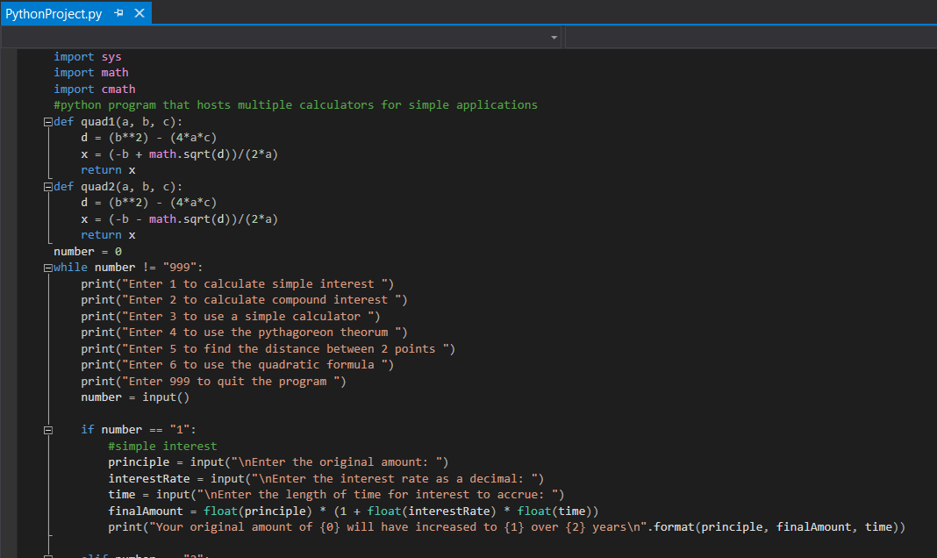
Project 3 - Description
6 Calculators
Simple
Pythagorean Theorem
Simple & Compound Interest
Distance Formula
Quadratic Formula

Slide 21
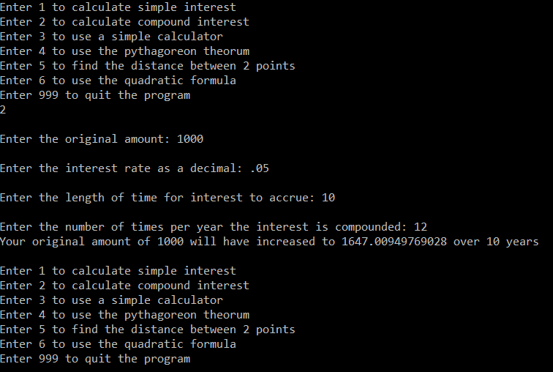
Project 3 – Input/output
Enter 1-6 to choose calculator or 999 to exit program
Follow directions for number input
Enter rates as decimals
Gain the answer for the selected calculator
Repeat until finished

Slide 22
Reflection
Learned
Documentation uses #
How if statements, while loops, and methods work
Math functions
Have more to learn
I want to continue honing this skill/language

Slide 23
Works Cited
Jain, S., Goel, S., Baranwal, S., & Singh, D. (n.d.). Python Programming Language. Retrieved June 2020, from https://www.geeksforgeeks.org/python- programming-language/
Mark Otto, J. T. (2010). Bootstrap. Retrieved June 2020, from https://getbootstrap.com/
Joey for the music
Unity Store

